Slide 1
What is Cross-Entropy ?

Slide 2
Definition:
How close is the predicted distribution from the true distribution.

Slide 3
For example, suppose for a specific training instance, the true label is B (out of the possible labels A, B, and C). The one-hot distribution for this training instance is therefore:
Pr [class A ]
0.0
Pr [class B ]
1.0
Pr [class C ]
0.0

Slide 4
Now after applying the machine learning algorithm
Pr [class A ]
0.38
Pr [class B ]
0.59
Pr [class C ]
0.03

Slide 5
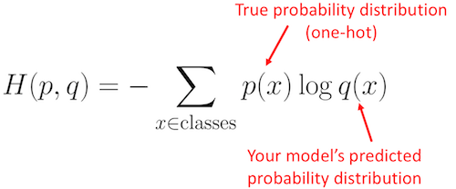
Formula for calculating cross-entropy

Slide 6
H = - (0.0*ln(0.38) + 1.0*ln(0.59) + 0.0*ln(0.03)) = 0.527
Predicted Pr by our Machine Leaning Algorithm
Actual Pr of class A, B and C

Slide 7
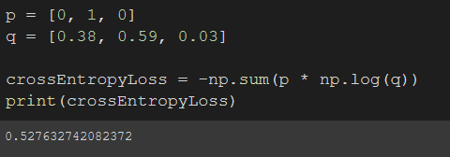
Therefore, the loss is 0.527

